Slide 1

Multivariate Transfer Function
Using a Multivariate Transfer Function to Forecast the VGSLX
MTH 541: Mathematics Clinic
Instructor: Dr. Maher Qumsiyeh
Term: Spring 2023
Student Name: Serge Alhalbi

Slide 2
Outline
INTRODUCTION
Data visualization
Flow Chart
ANALYSIS
Preprocessing
The output variable
The input variables
Transfer function with the first input
First input filter and cross-correlation
Preliminary transfer function with the first input
Transfer function with the second input
Second input filter and cross-correlation
Preliminary transfer function with the second input
Diagnostics and final model
Final model without modeled noise
Final model with modeled noise
FORECASTING RESULTS
CONCLUSION

Slide 3
Data Visualization
The dataset consists of three time-series: Vanguard Real Estate Index Fund (VGSLX), S&P 500 Index (^GSPC), and McDonald’s (MCD).
The data is almost daily and contains 505 values measured from the start of 2020 to the end of 2021.
The VGSLX is the output variable, and the other two time series are input variables.

Slide 4
Data Visualization
The data has been collected from Yahoo Finance.

Slide 5
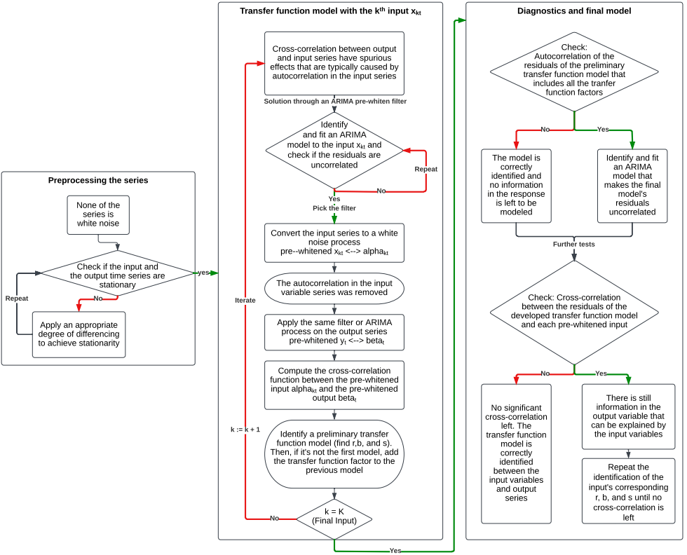
Flow Chart

Slide 6
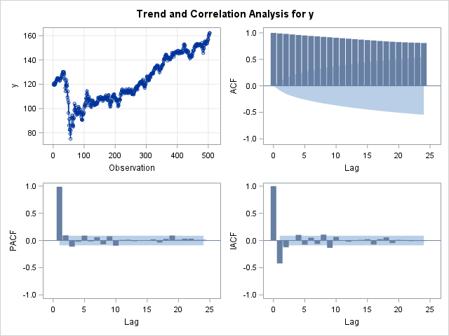
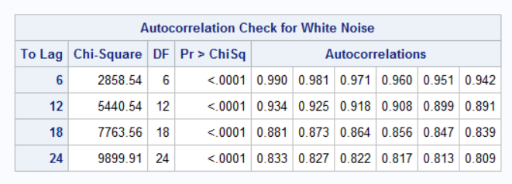
Preprocessing
The Output Variable: y
P-values are small => no autocorrelation is rejected
The series is not white noise according to the table on the bottom right
Visually, the series is not stationary

Slide 7
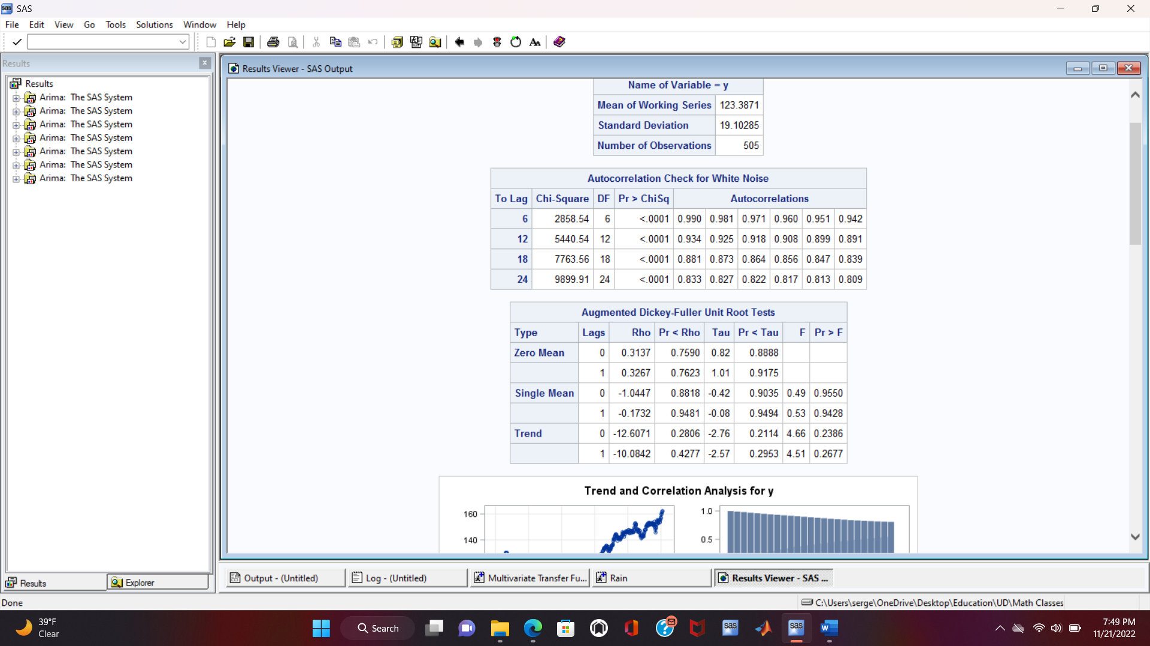
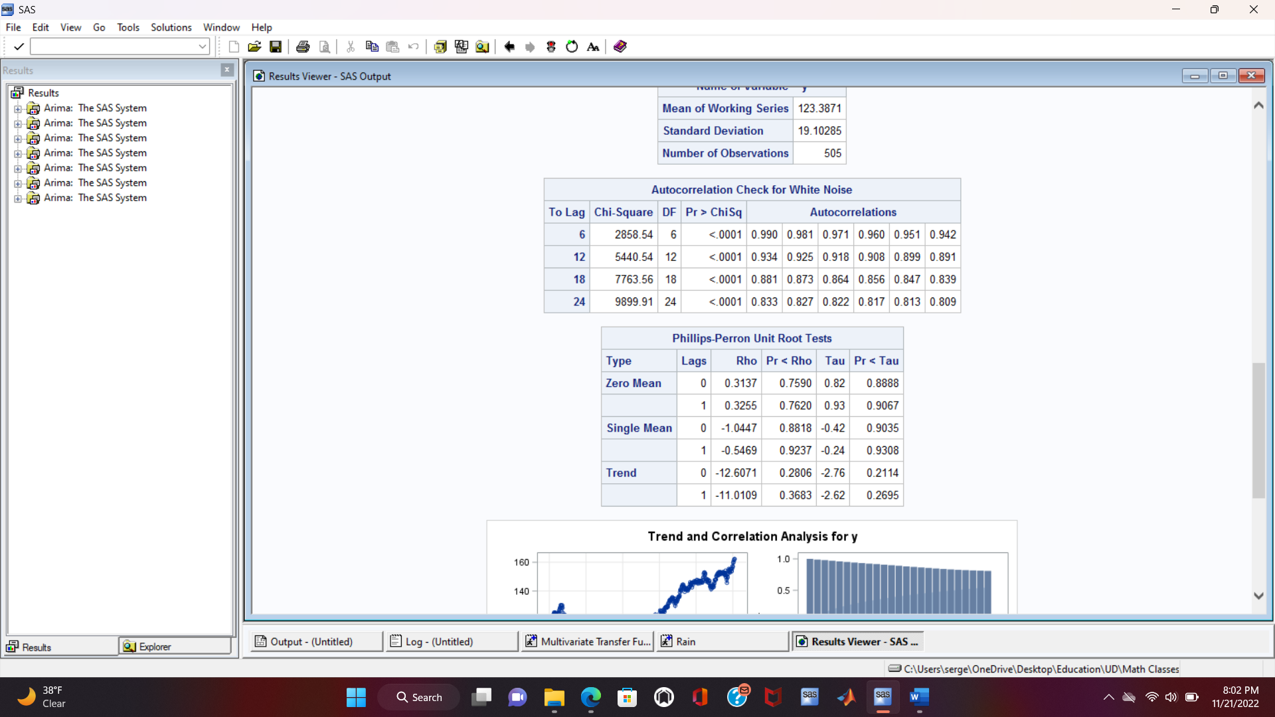
Preprocessing
The Output Variable: y
P-values are large => no zero mean, no single mean, and no trend are accepted (Although the trend is obvious)
The series is not stationary according to both ADF and PP tests

Slide 8
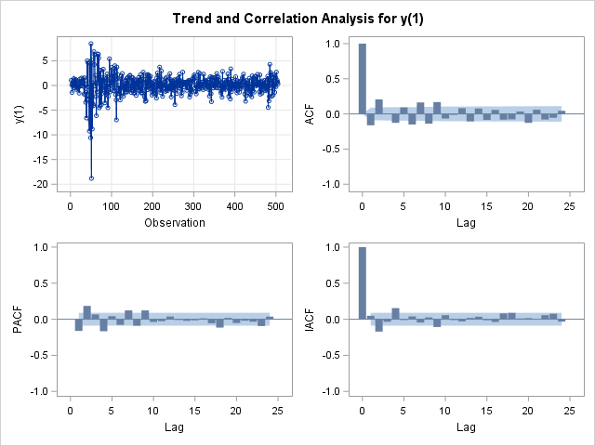
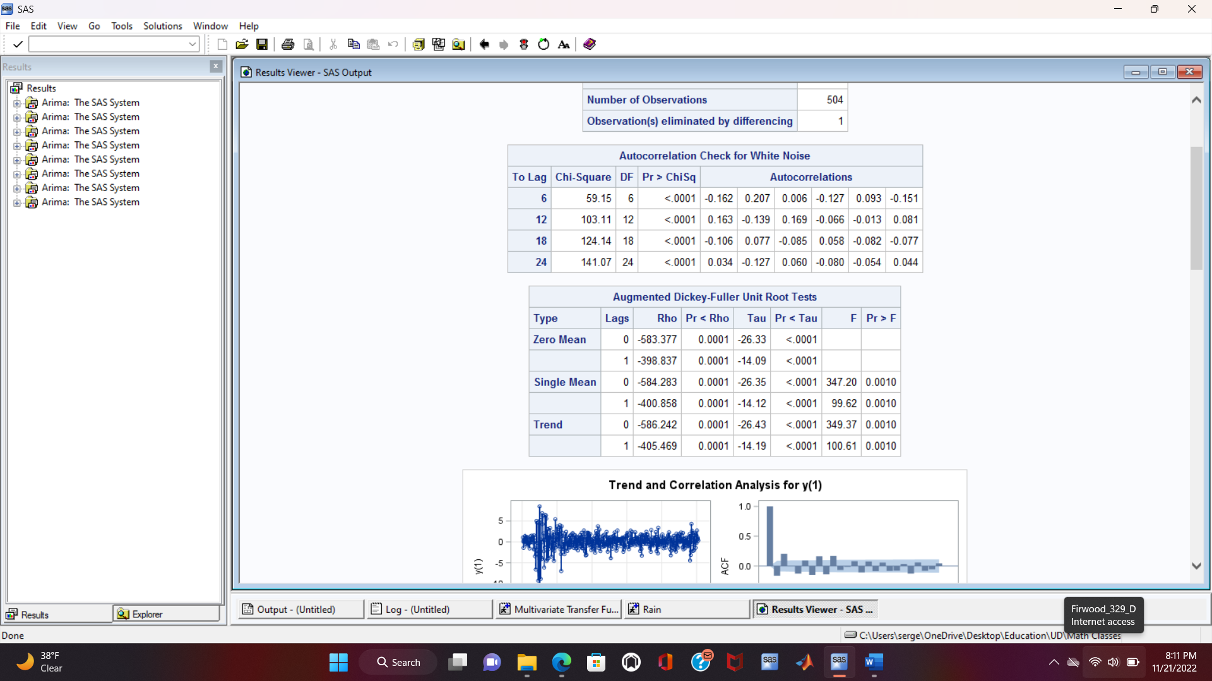
Preprocessing
The Output Variable: y(1)
First order regular differencing
P-values are small => no autocorrelation is rejected
The series is not white noise according to the table on the bottom right
Visually, the series seems stationary

Slide 9
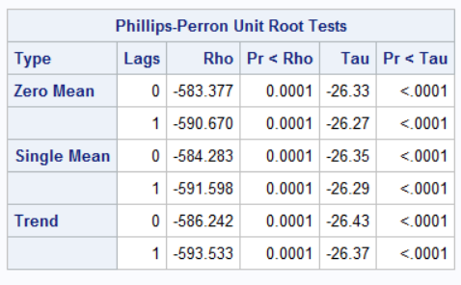
Preprocessing
The Output Variable: y(1)
P-values are large => no zero mean, no single, and no trend are rejected
The series is stationary according to both ADF and PP tests

Slide 10
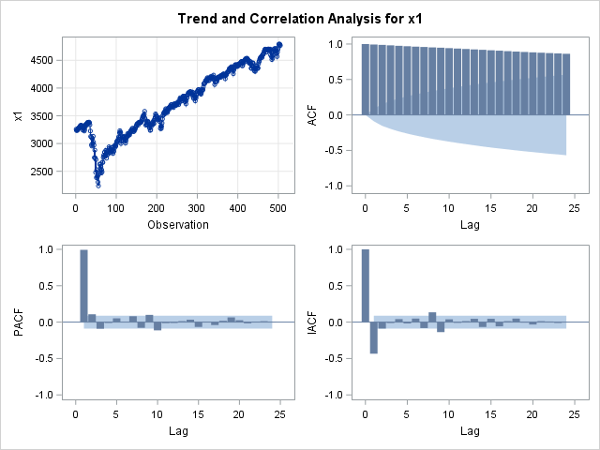
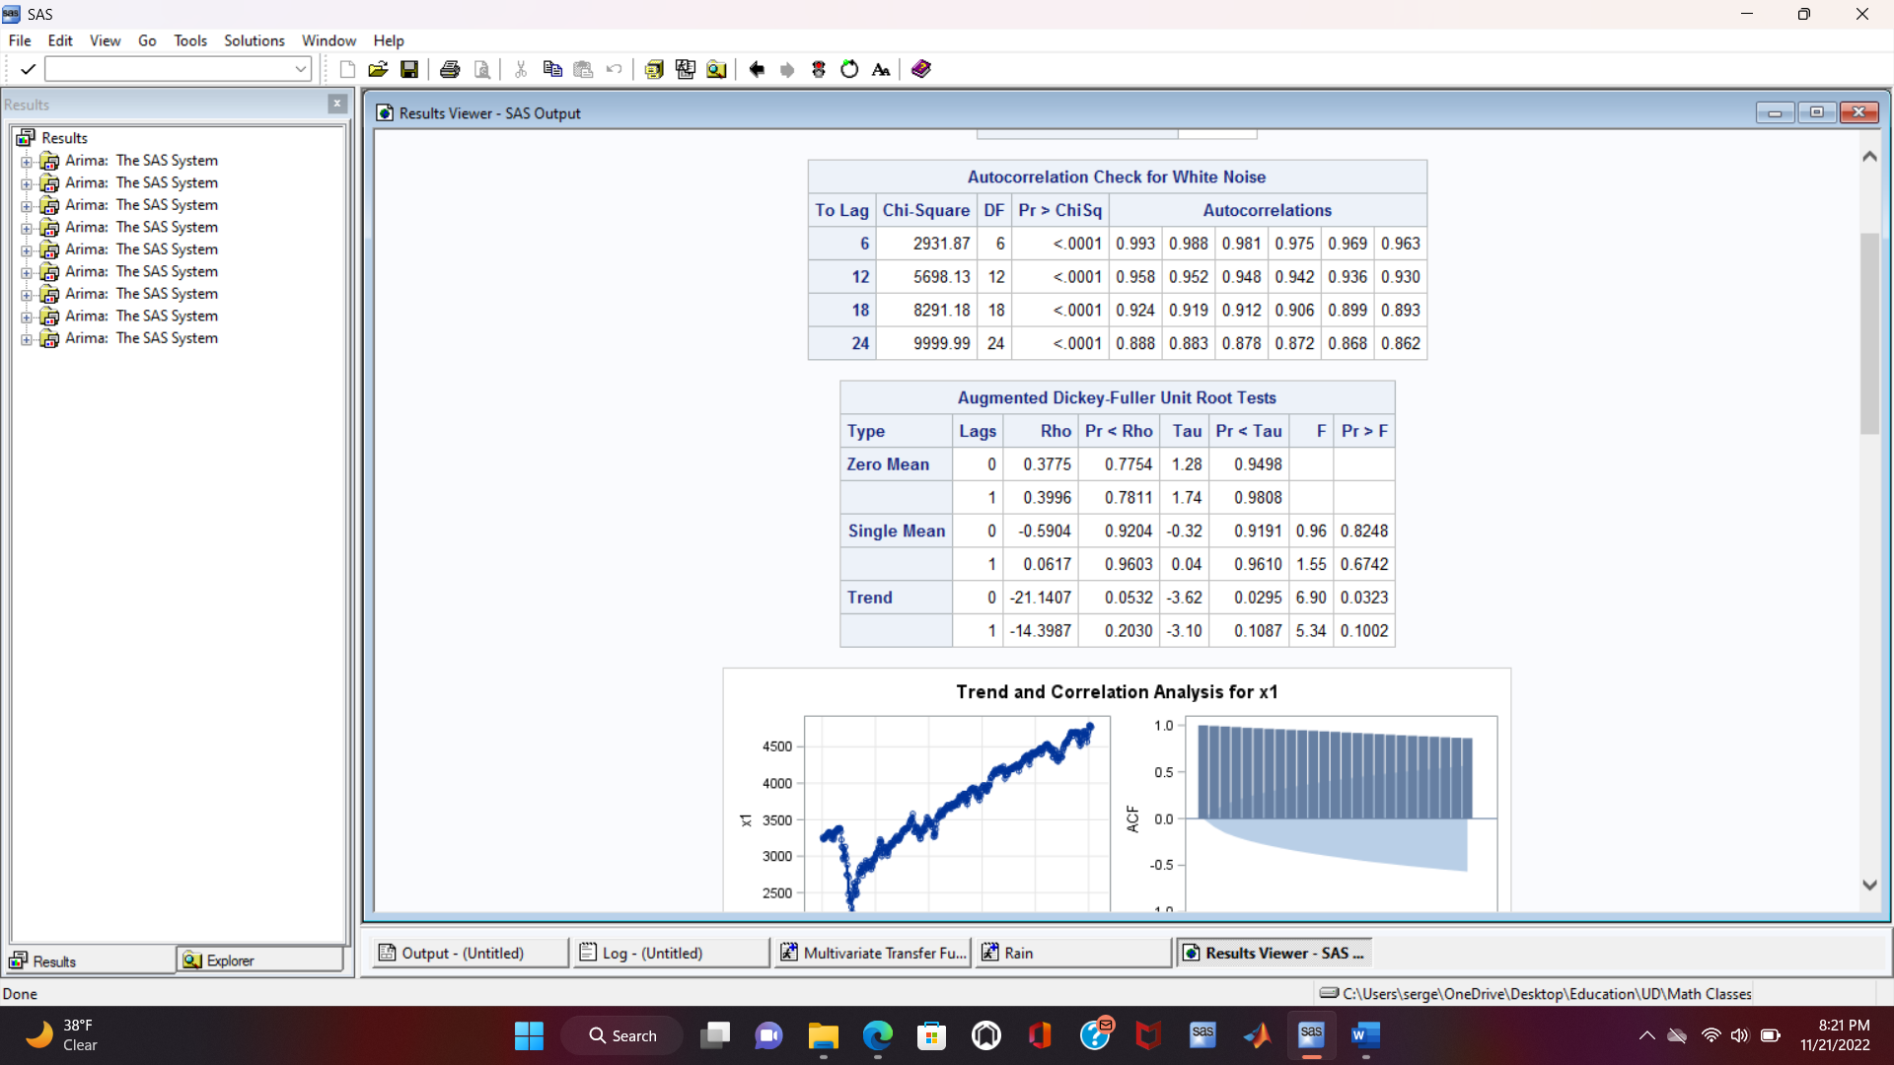
Preprocessing
The First Input Variable: x1
P-values are small => no autocorrelation is rejected
The series is not white noise according to the table on the bottom right
Visually, the series is not stationary

Slide 11
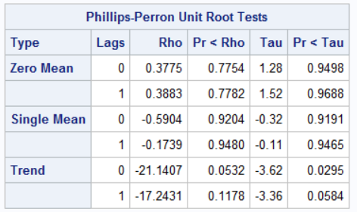
Preprocessing
The First Input Variable: x1
P-values are large => no zero mean, no single mean, and no trend are accepted (Although the trend is obvious)
The series is not stationary according to both ADF and PP tests

Slide 12
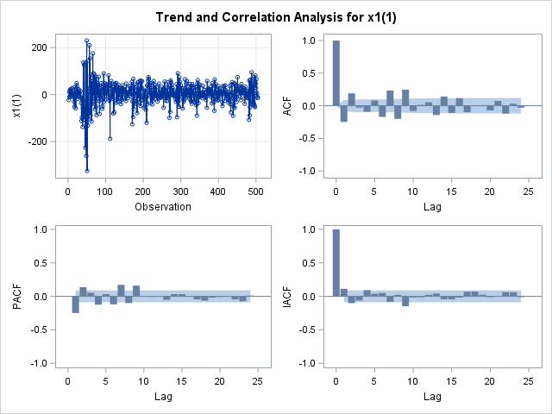
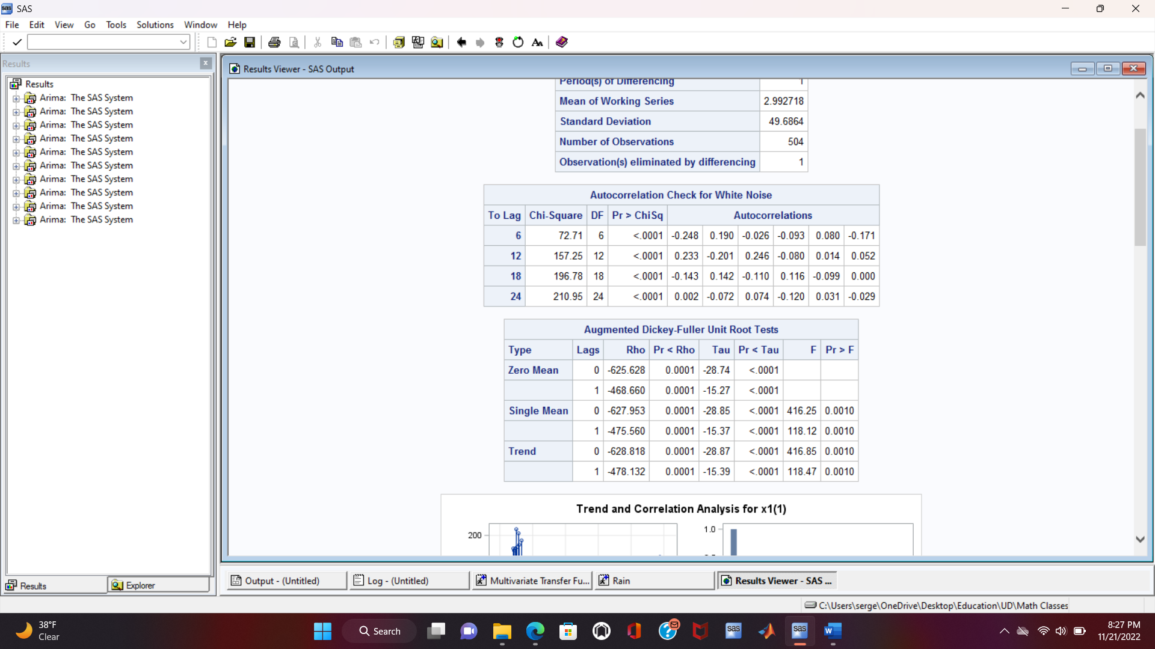
Preprocessing
The First Input Variable: x1(1)
First order regular differencing
P-values are small => no autocorrelation is rejected
The series is not white noise according to the table on the bottom right
Visually, the series seems stationary

Slide 13
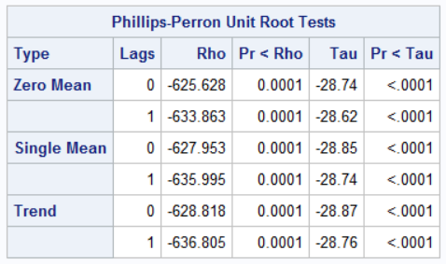
Preprocessing
The First Input Variable: x1(1)
P-values are large => no zero mean, no single, and no trend are rejected
The series is stationary according to both ADF and PP tests

Slide 14
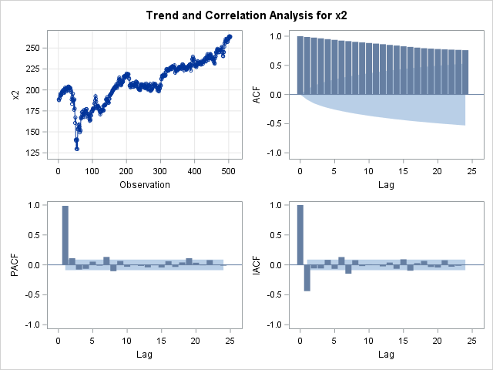
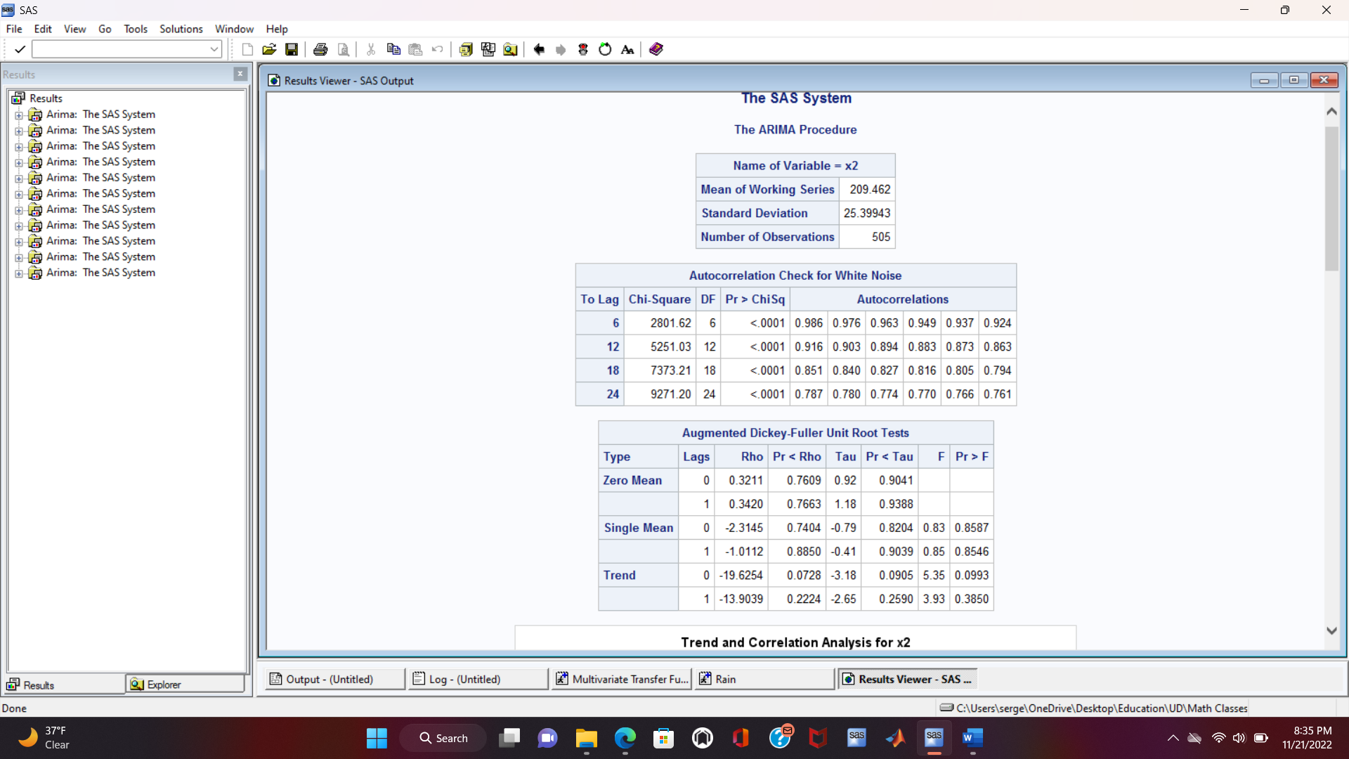
Preprocessing
The Second Input Variable: x2
P-values are small => no autocorrelation is rejected
The series is not white noise according to the table on the bottom right
Visually, the series is not stationary

Slide 15
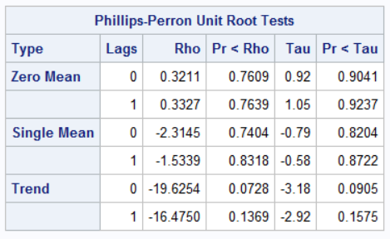
Preprocessing
The Second Input Variable: x2
P-values are large => no zero mean, no single mean, and no trend are accepted (Although the trend is obvious)
The series is not stationary according to both ADF and PP tests

Slide 16
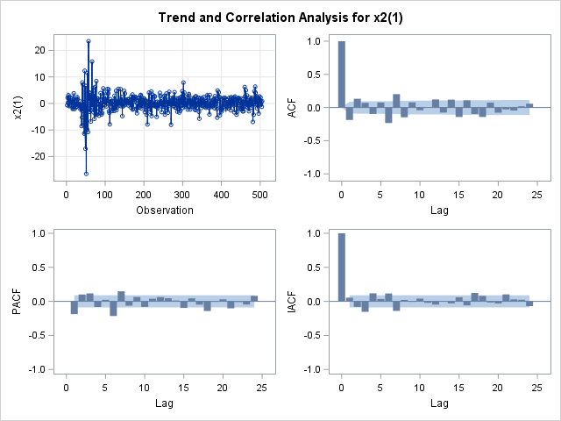
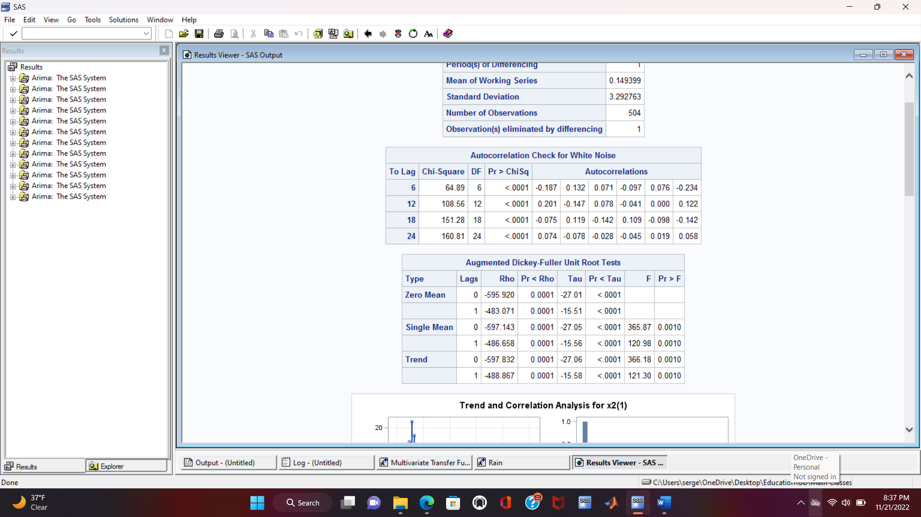
Preprocessing
The Second Input Variable: x2(1)
First order regular differencing
P-values are small => no autocorrelation is rejected
The series is not white noise according to the table on the bottom right
Visually, the series seems stationary

Slide 17
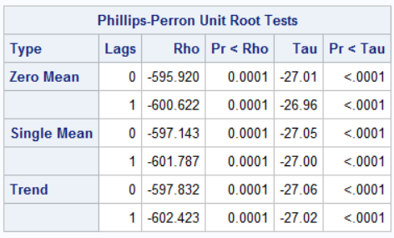
Preprocessing
The Second Input Variable: x2(1)
P-values are large => no zero mean, no single, and no trend are rejected
The series is stationary according to both ADF and PP tests

Slide 18
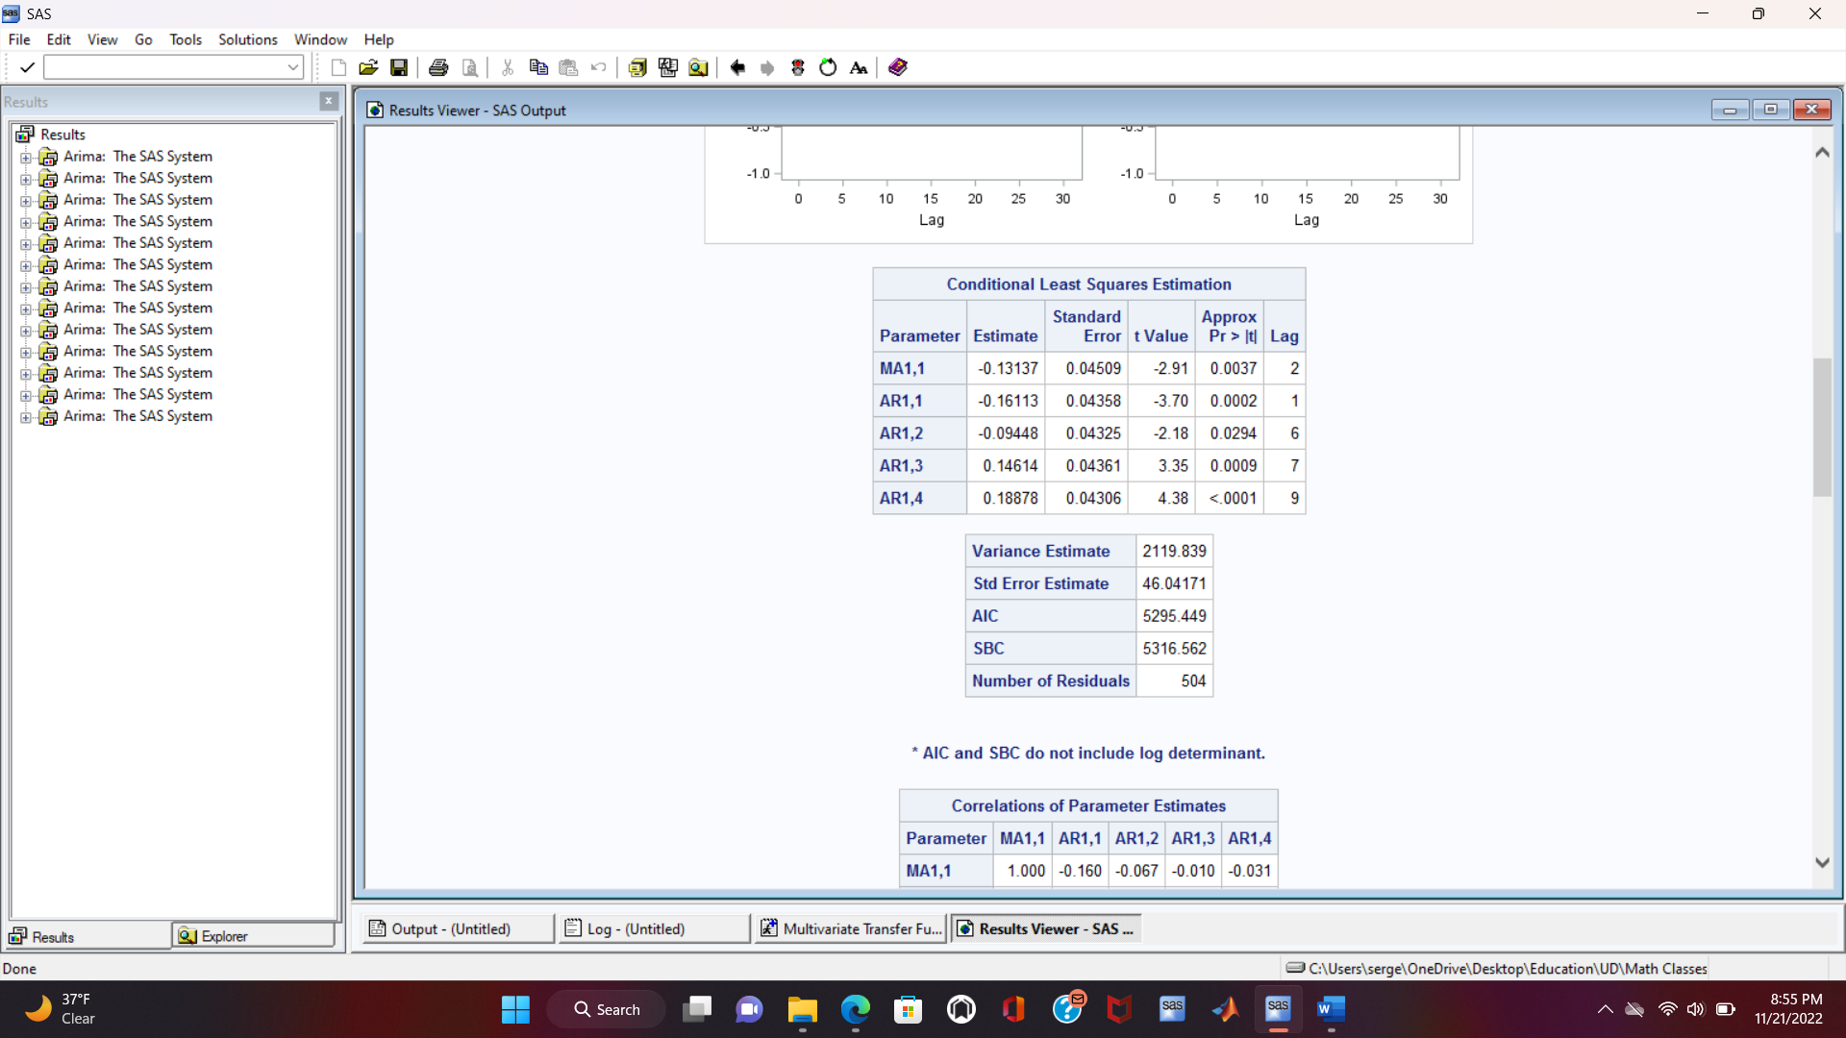
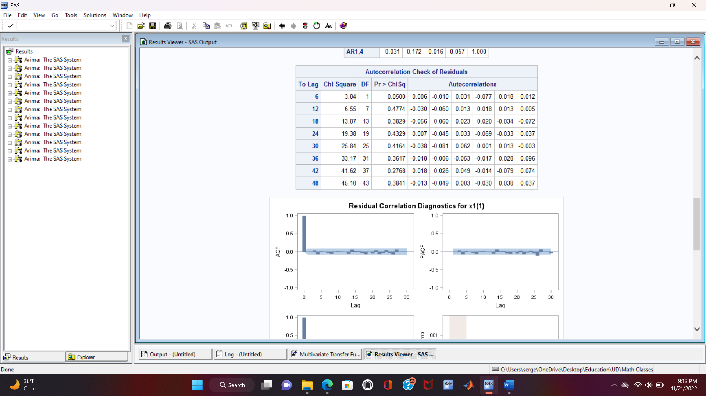
Transfer Function with the First Input
First Input Filter:
Model: ARIMA([1,6,7,9], 1, [2])
The p-values are low in the first table and thus the null hypotheses for having insignificant parameters are rejected and all the parameters are significant
The p-values are high in second table and thus the null hypothesis for having no autocorrelation in the residuals at different lags is accepted

Slide 19
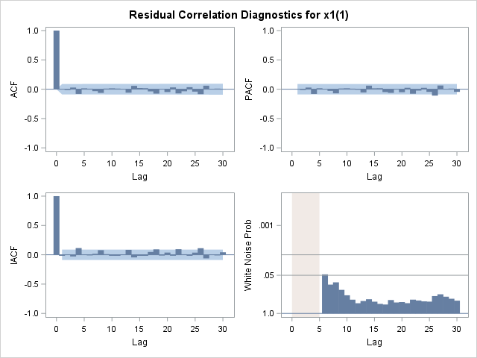
Transfer Function with the First Input
First Input Filter:
No spikes in the SAC and SPAC graphs meaning the residuals are not autocorrelated
The probability for the residuals of being white noise is high

Slide 20
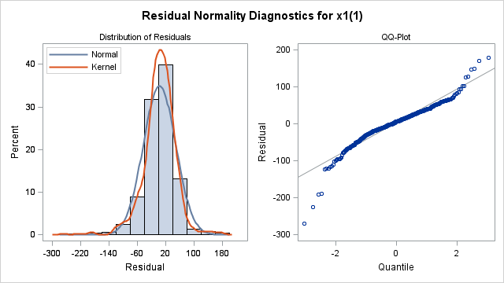
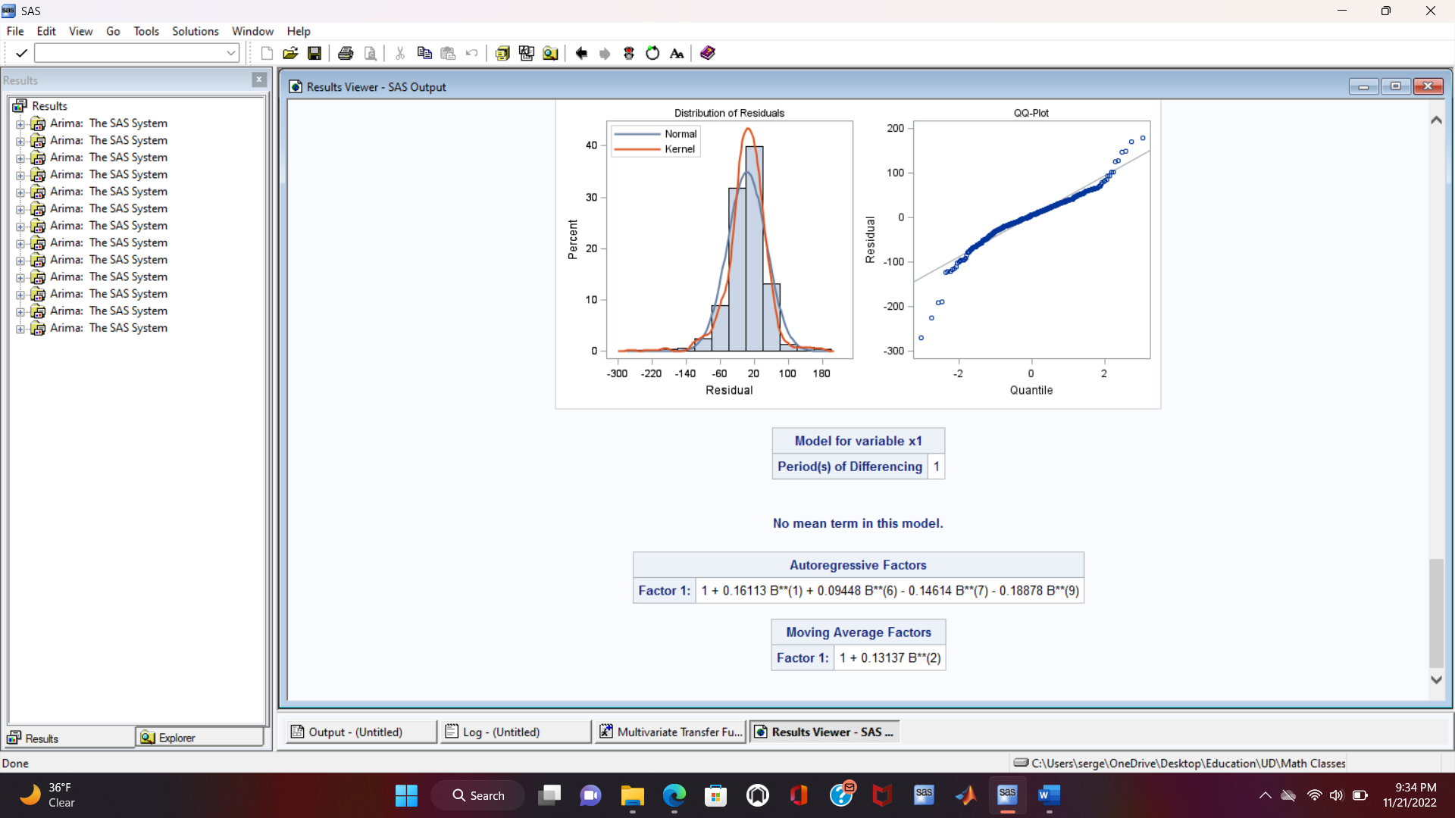
Transfer Function with the First Input
First Input Filter:
The distribution of the residuals should be close to a Gaussian one centered at zero
There is more probability that the residual will have a zero value
The equation of the model can be written now after the least squares estimation of the parameters

Slide 21
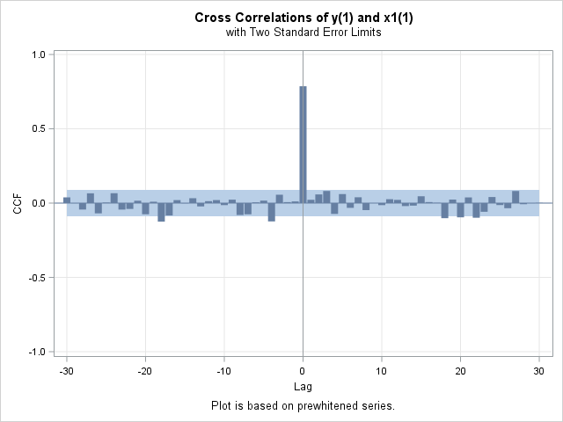
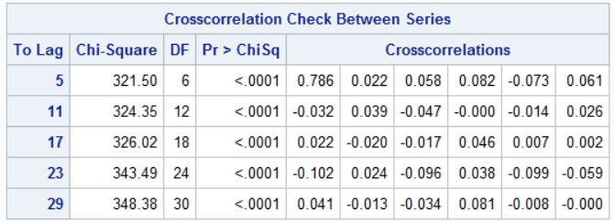
Transfer Function with the First Input
First Input Cross-correlation:
The output series will be passed through the same filter and the residuals will be the new series used in the CCF
P-values are low, the no cross-correlation between the series hypothesis is rejected. Thus, the series are correlated
This can be observed in the graph as well. The spike indicates there is correlation

Slide 22
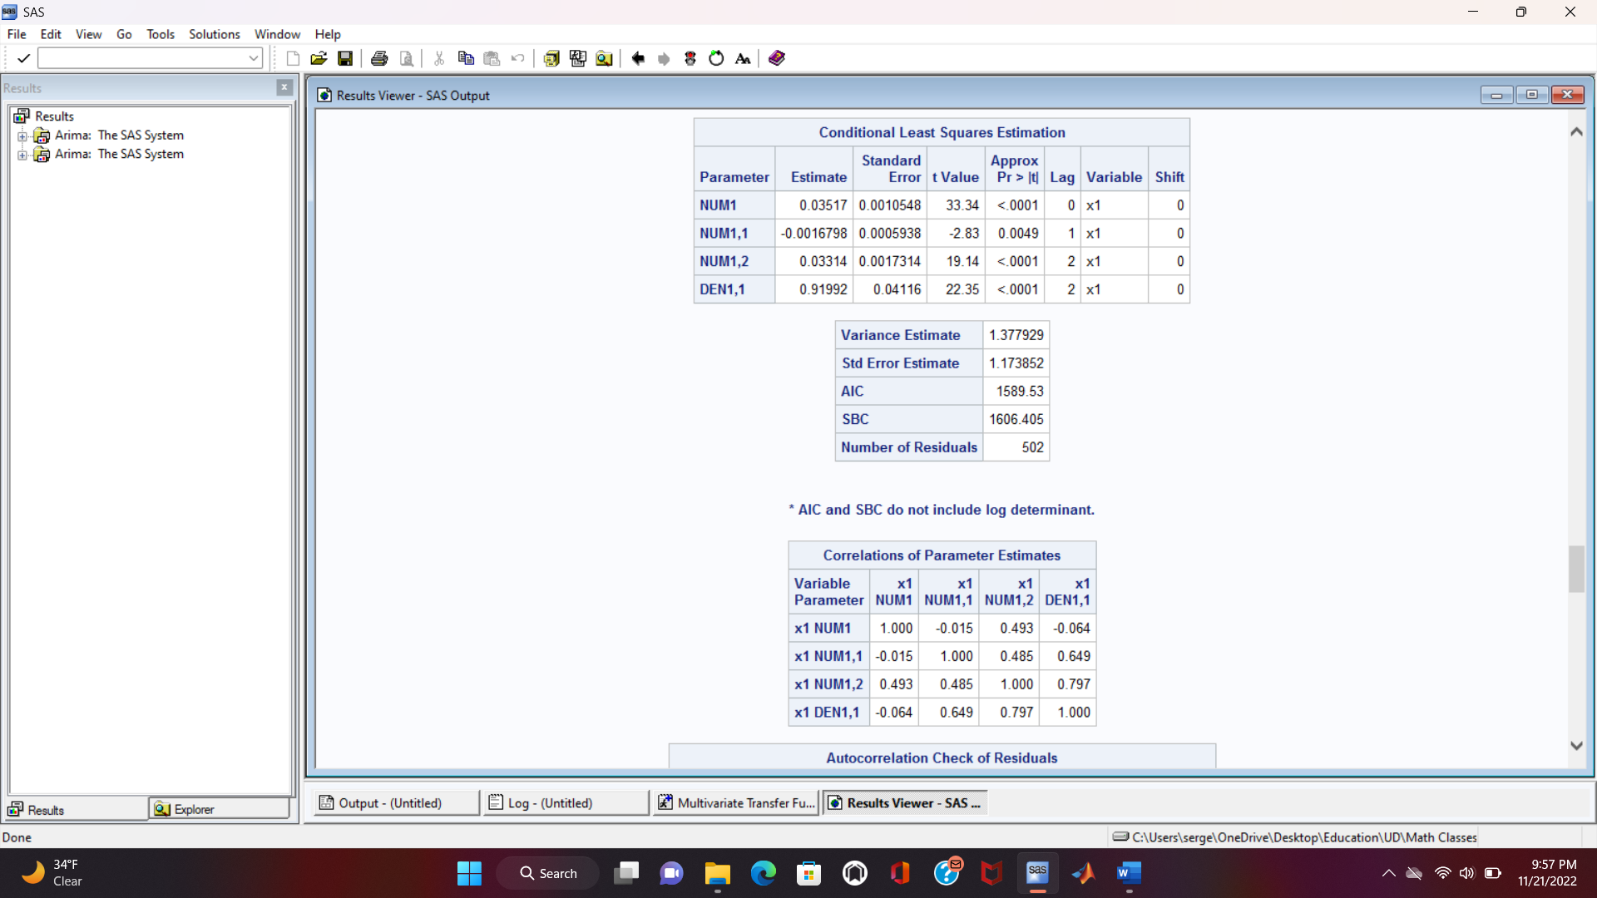
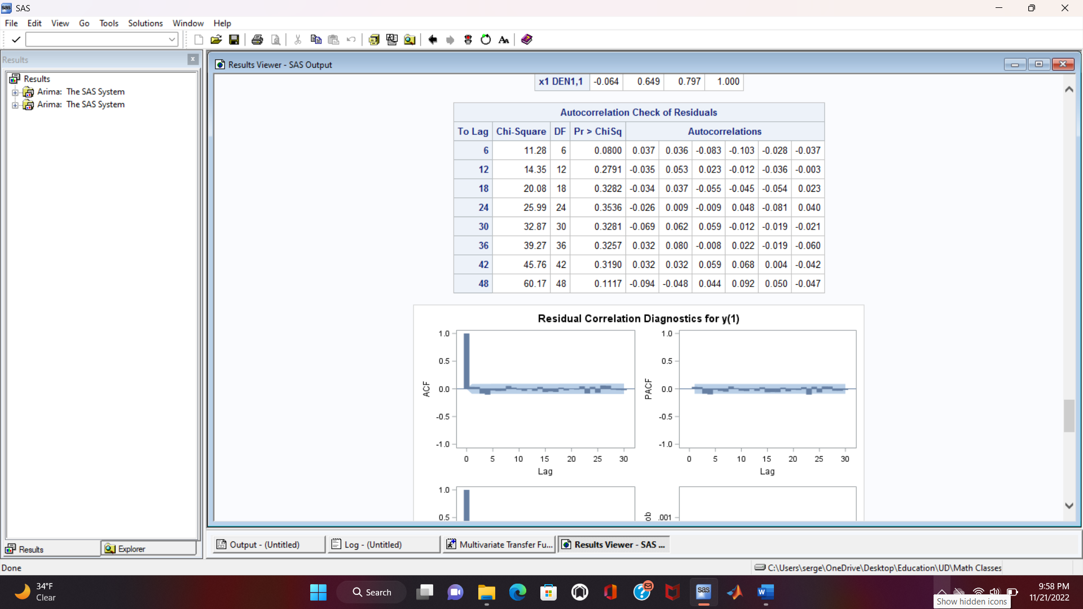
Transfer Function with the First Input
Preliminary transfer function with the first input:
Model: b=0; r=(1,2); s=2
All the parameters are significant
No autocorrelation in the residuals

Slide 23
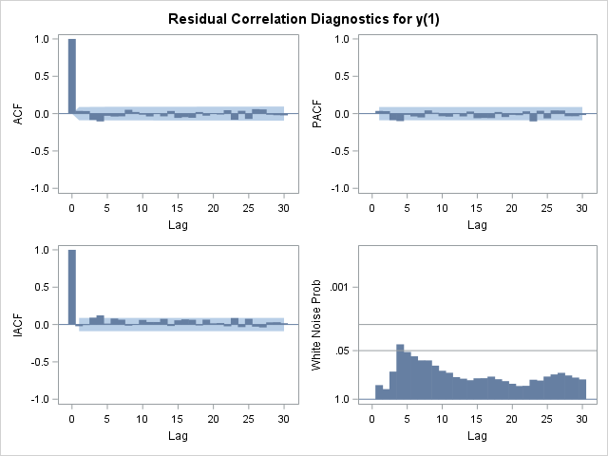
Transfer Function with the First Input
Preliminary transfer function with the first input:
No spikes in the SAC and SPAC graphs meaning the residuals are not autocorrelated
The probability for the residuals of being white noise is high

Slide 24
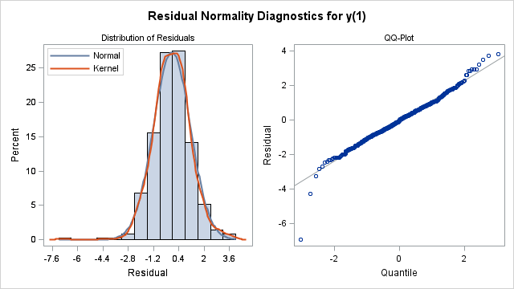
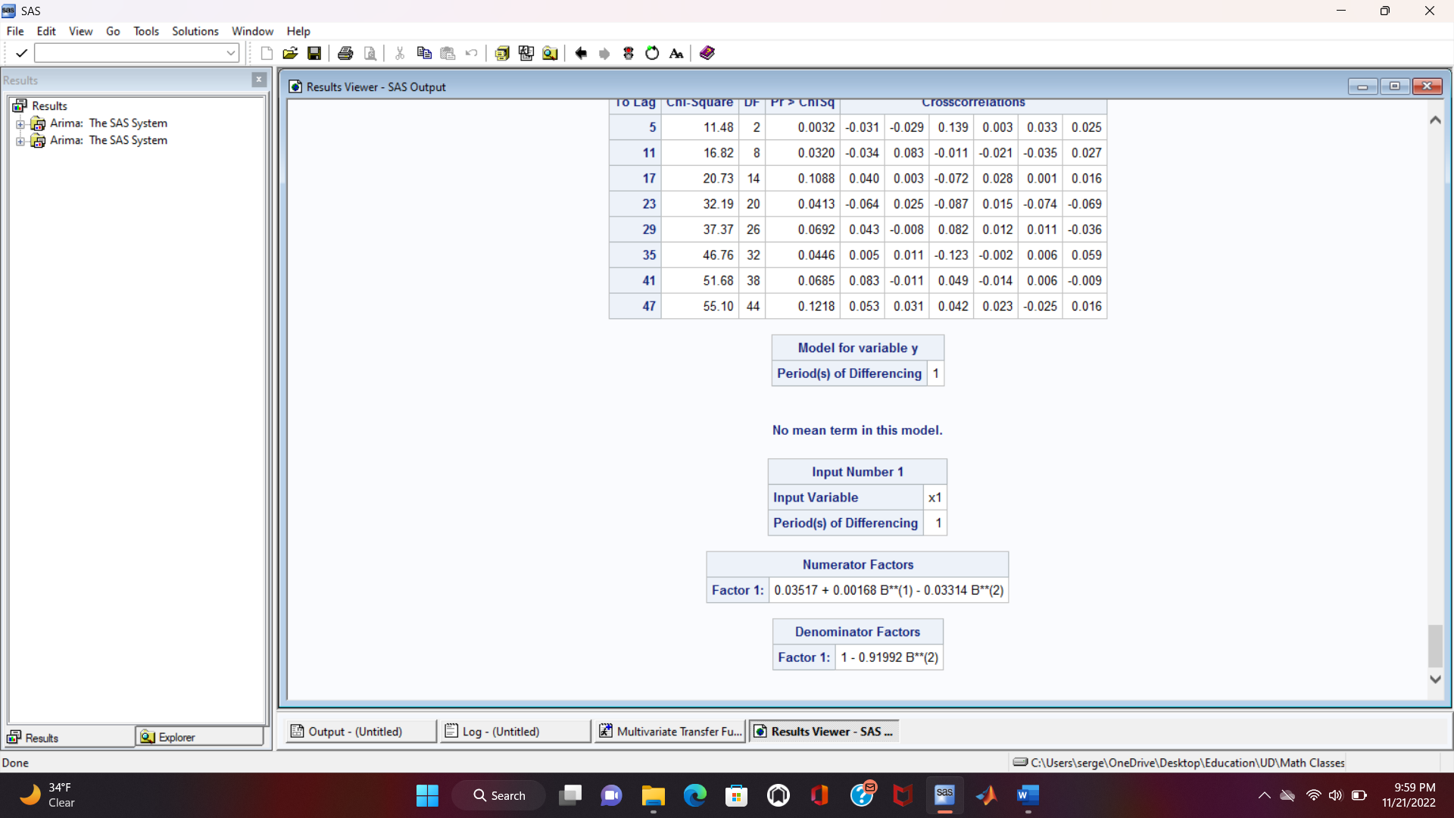
Transfer Function with the First Input
Preliminary transfer function with the first input:
The distribution of the residuals should be close to a Gaussian one centered at zero
There is more probability that the residual will have a zero value
The equation of the model can be written now after the least squares estimation of the parameters

Slide 25
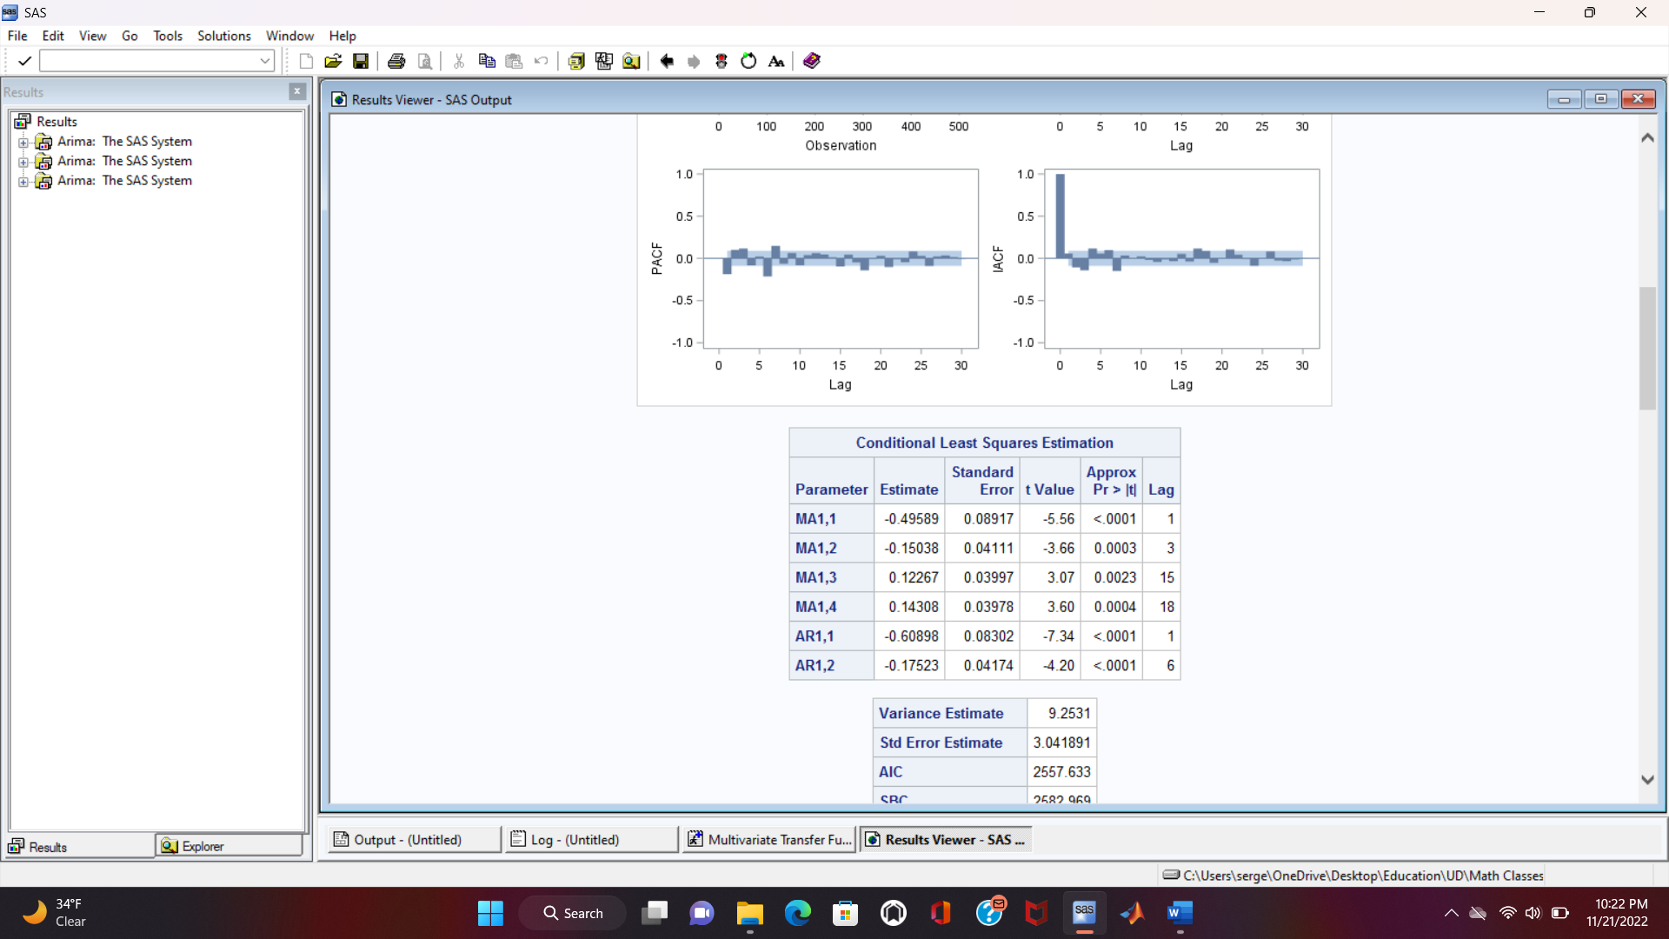
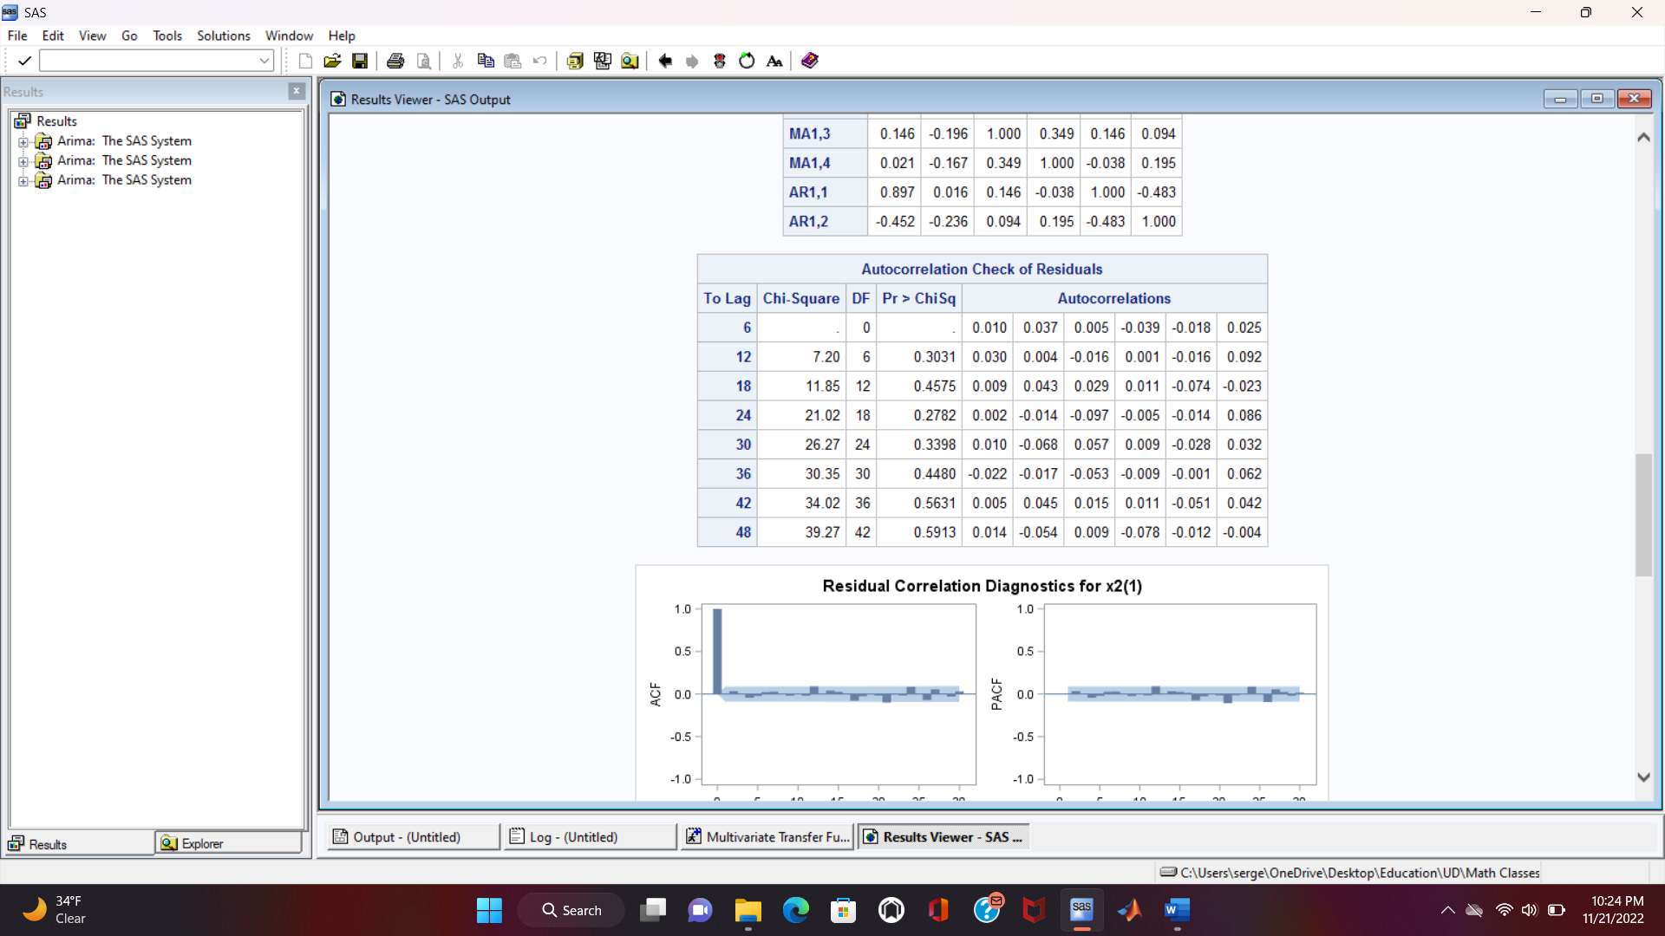
Transfer Function with the Second Input
Second Input Filter:
Model: ARIMA([1,6], 1, [1,3,15,18])
All the parameters are significant
No autocorrelation in the residuals

Slide 26
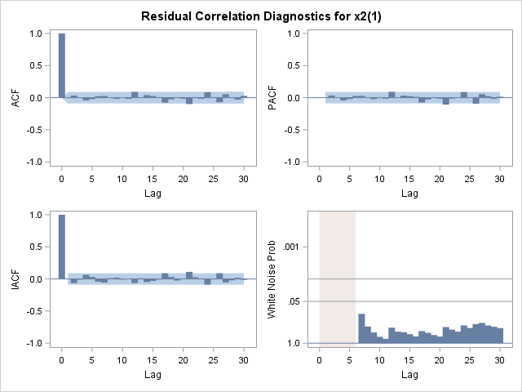
Transfer Function with the Second Input
Second Input Filter:
No spikes in the SAC and SPAC graphs meaning the residuals are not autocorrelated
The probability for the residuals of being white noise is high

Slide 27
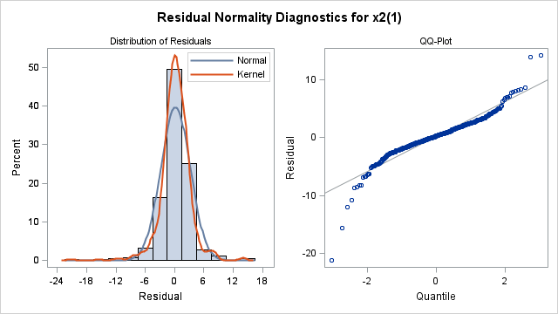
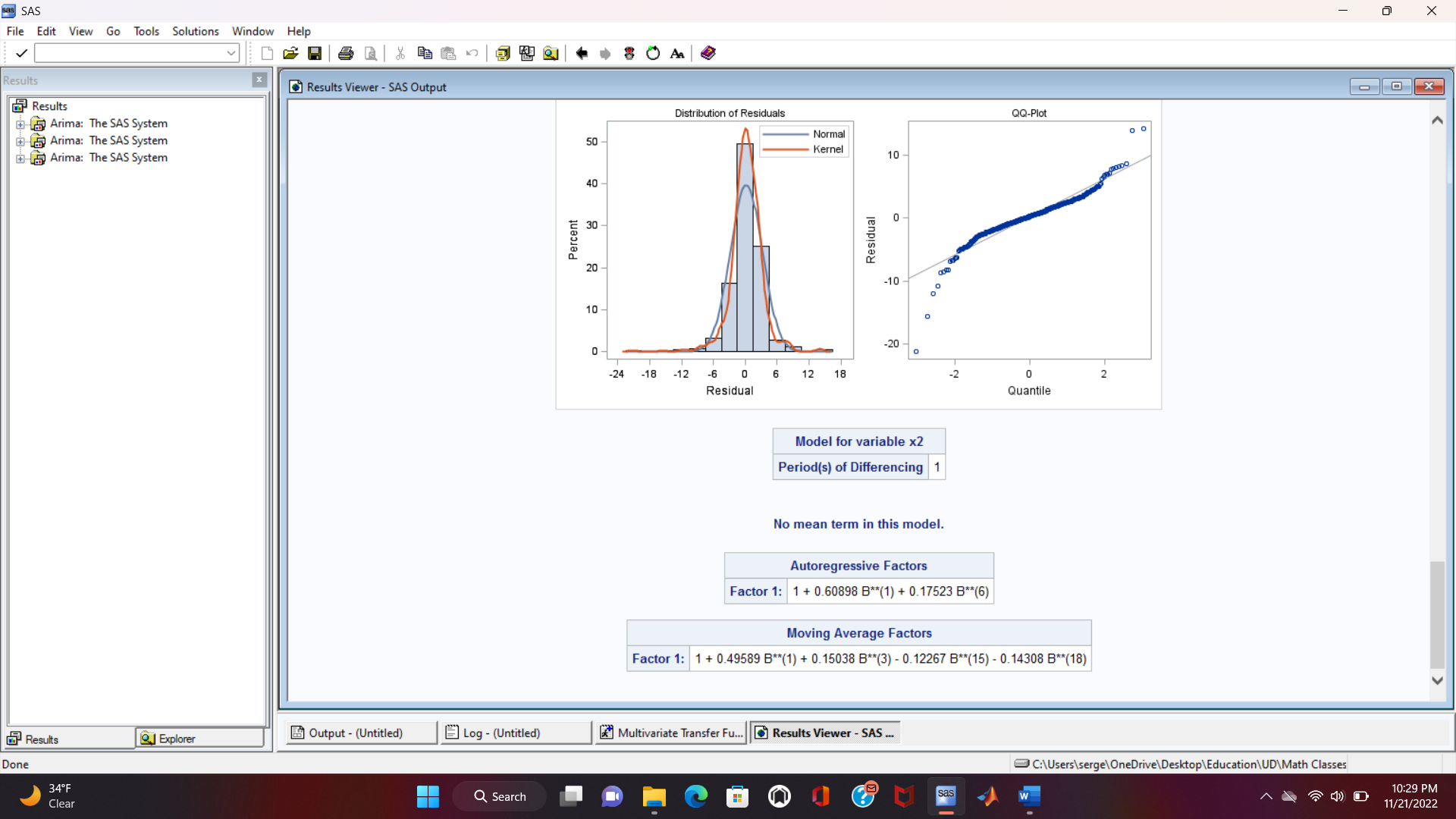
Transfer Function with the Second Input
Second Input Filter:
The distribution of the residuals should be close to a Gaussian one centered at zero
There is more probability that the residual will have a zero value
The equation of the model can be written now after the least squares estimation of the parameters

Slide 28
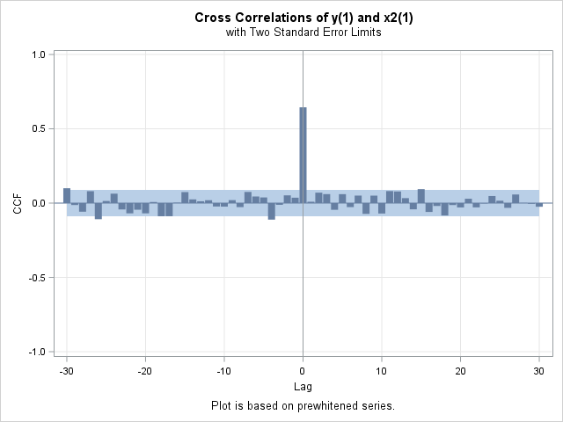
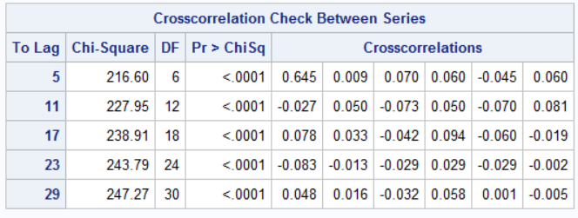
Transfer Function with the Second Input
Second Input Cross-correlation:
The series are correlated
This can be observed in the graph as well. The spike indicates there is correlation

Slide 29
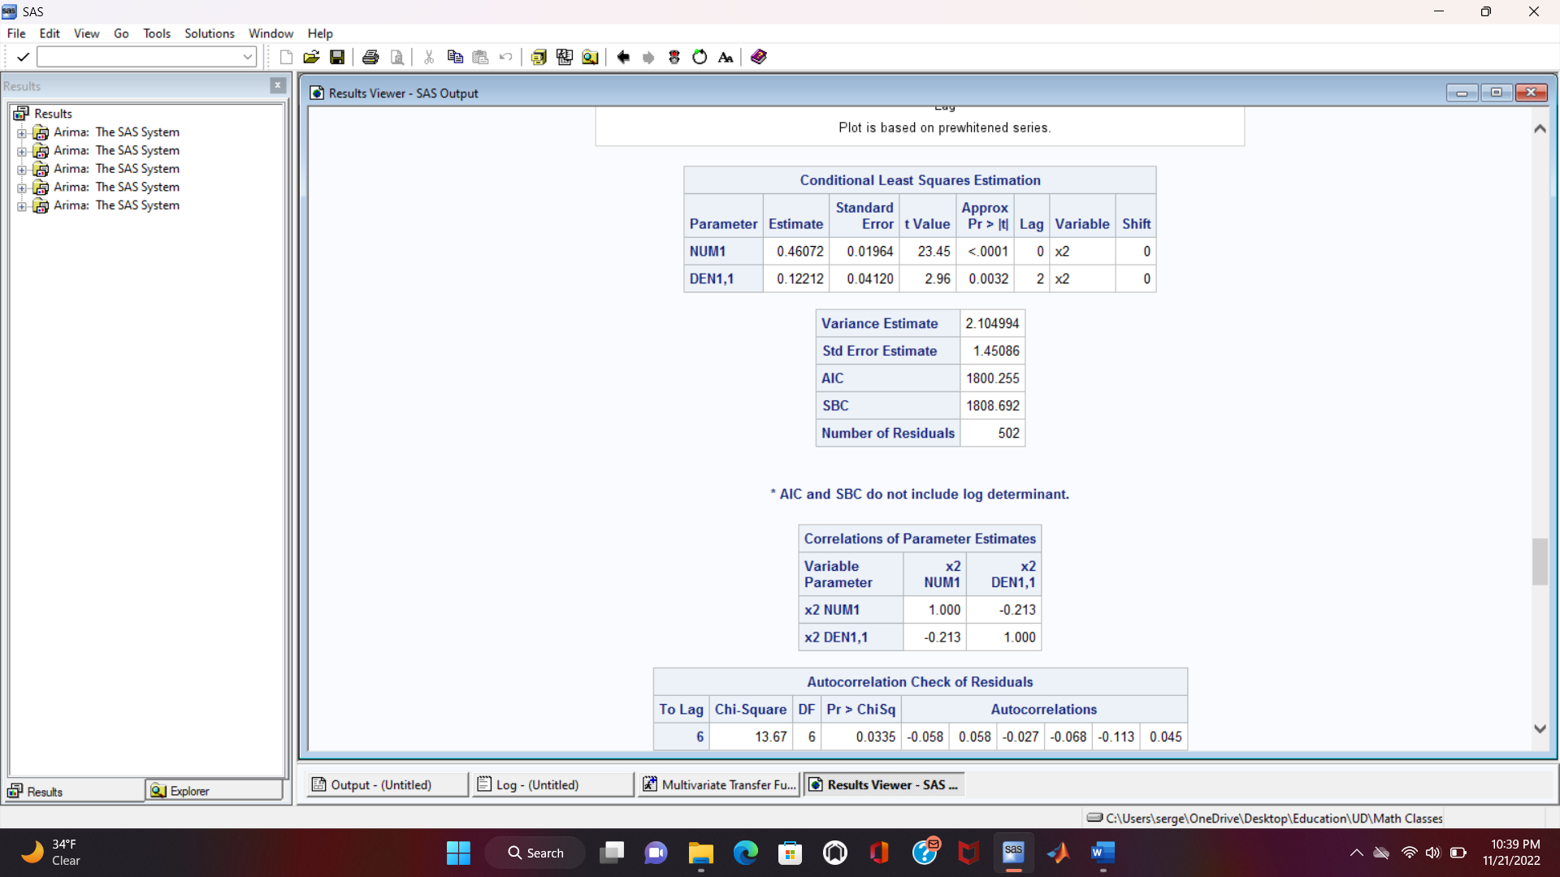
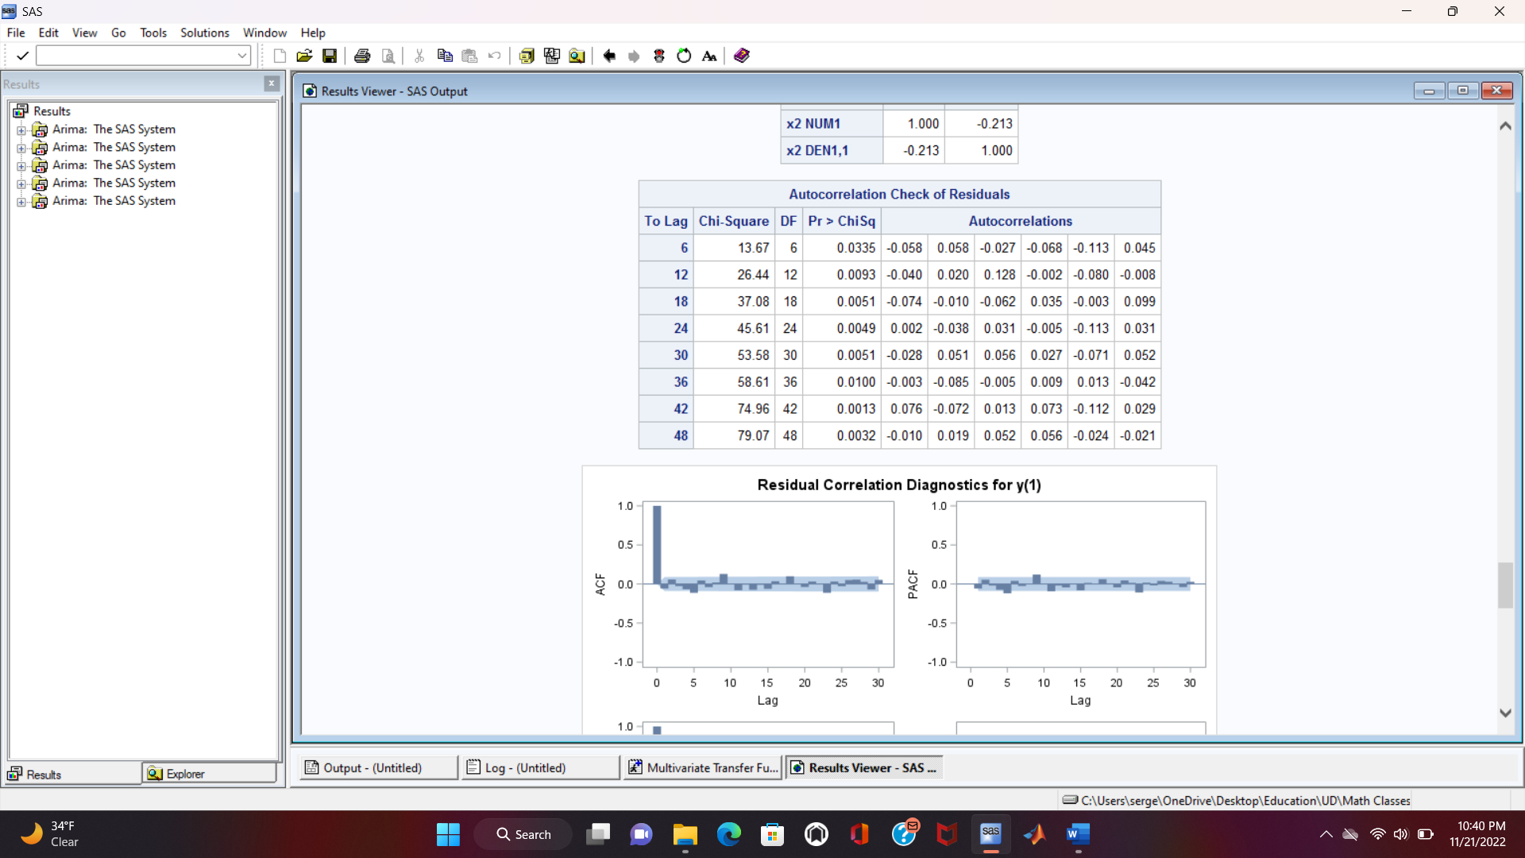
Transfer Function with the Second Input
Preliminary transfer function with the Second input:
Model: b=0; r=0; s=2
All the parameters are significant
There is autocorrelation in the residuals. This is yet to be solved

Slide 30
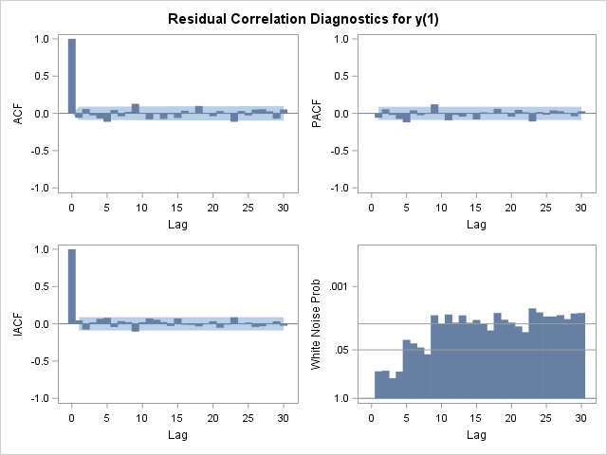
Transfer Function with the Second Input
Preliminary transfer function with the Second input:
Spikes in the SAC and SPAC graphs meaning the residuals are autocorrelated. This is fine since it’s a preliminary transfer function
The probability for the residuals of being white noise is low

Slide 31
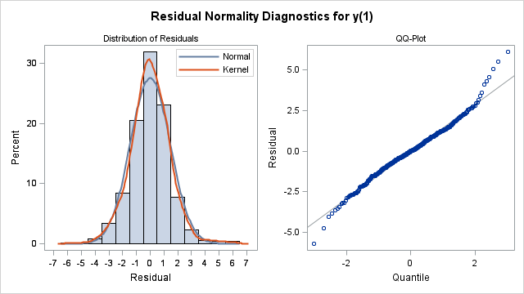
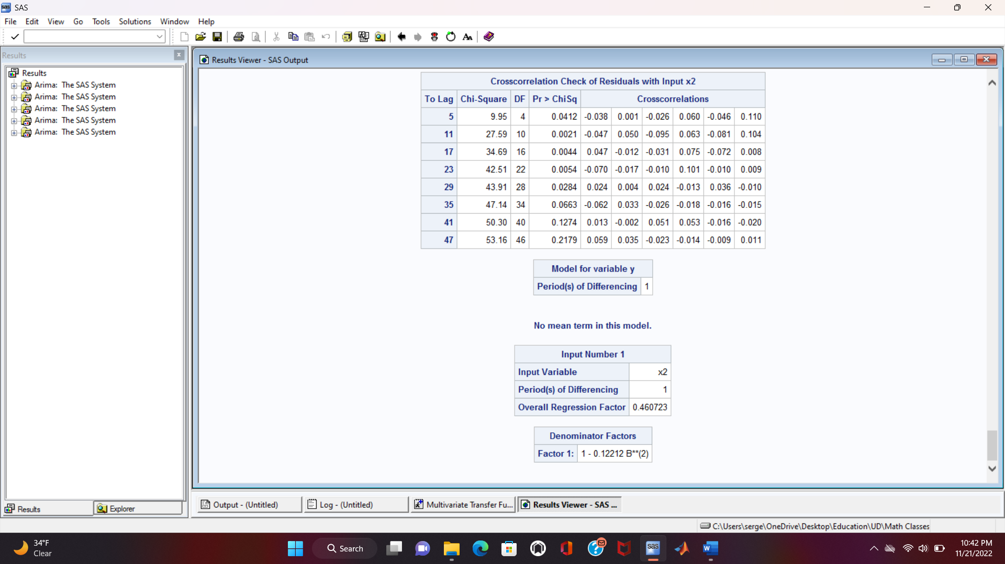
Transfer Function with the Second Input
Preliminary transfer function with the Second input:
The distribution of the residuals should be close to a Gaussian one centered at zero
There is more probability that the residual will have a zero value
The equation of the model can be written now after the least squares estimation of the parameters

Slide 32
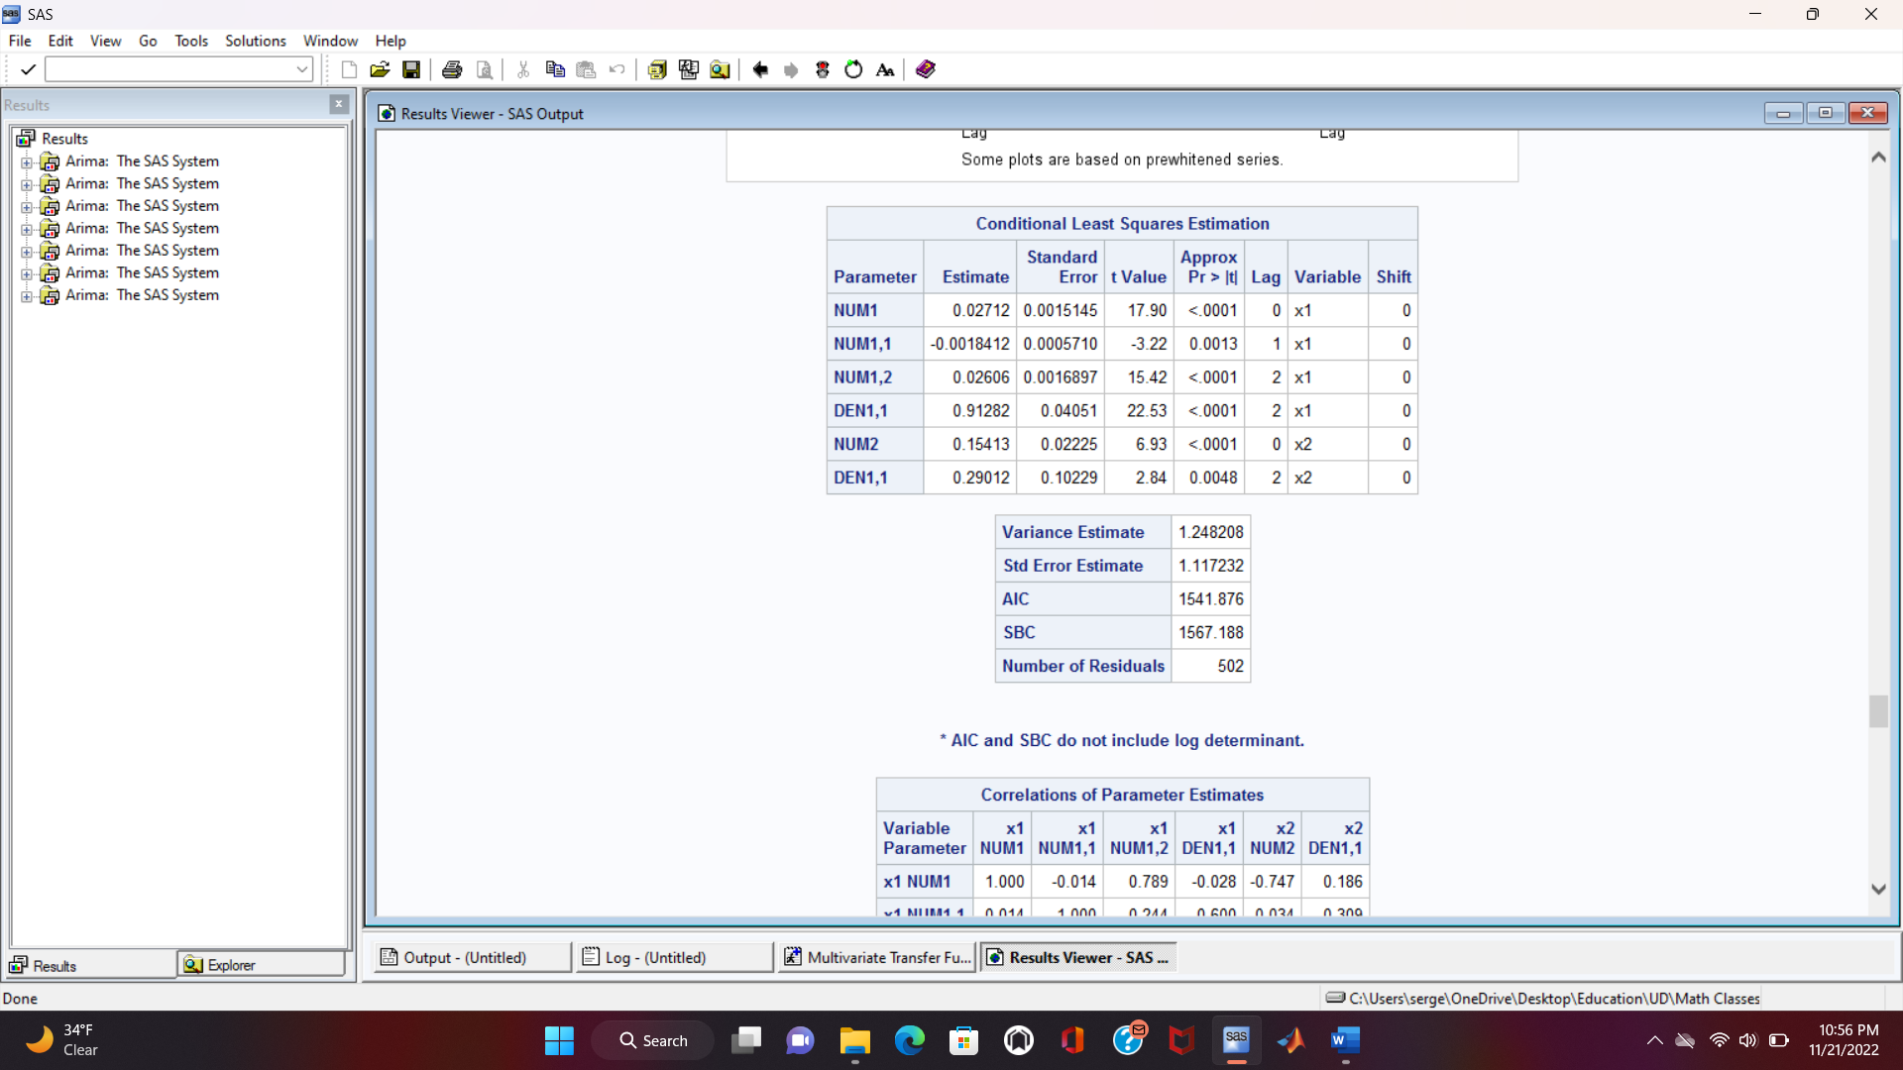
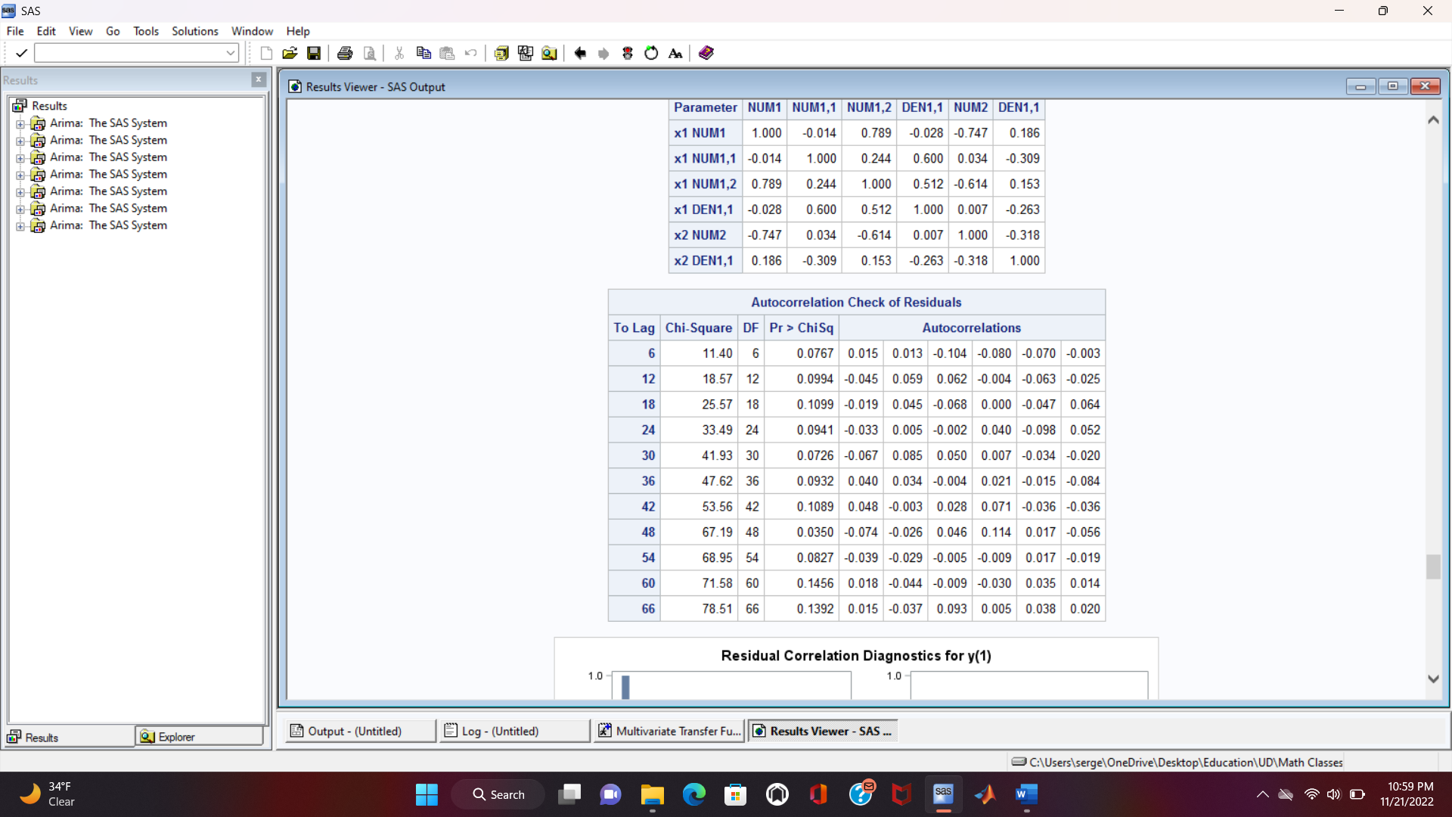
Diagnostics and final model
Final model without modeled noise:
Model: b1=0; r1=1,2; s1=2 b2=0; r2=0; s2=2
All the parameters are significant
No autocorrelation in the residuals. However, the P-values can be increased by modeling the noise that is still autocorrelated here

Slide 33
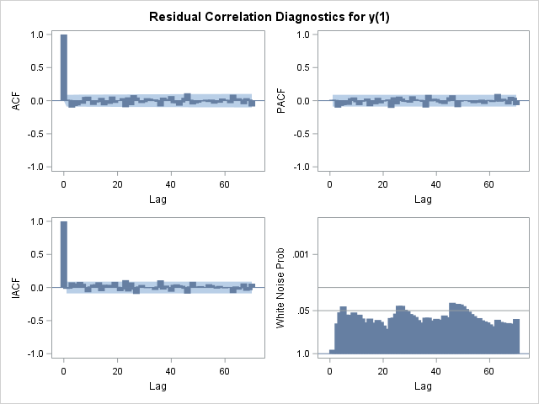
Diagnostics and final model
Final model without modeled noise:
Almost no spikes in the SAC and SPAC graphs meaning the residuals are not autocorrelated at most lags
The probability for the residuals of being white noise is high. However, it is crossing the line at some lags. A better model is still to be built

Slide 34
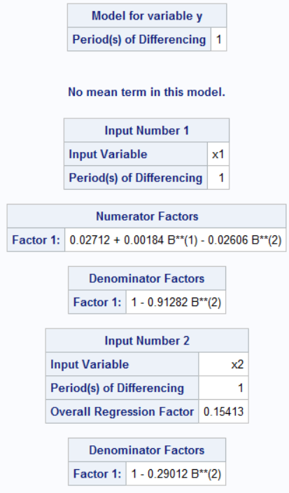
Diagnostics and final model
Final model without modeled noise:
The distribution of the residuals should be close to a Gaussian one centered at zero
There is more probability that the residual will have a zero value
The equation of the model can be written now after the least squares estimation of the parameters

Slide 35
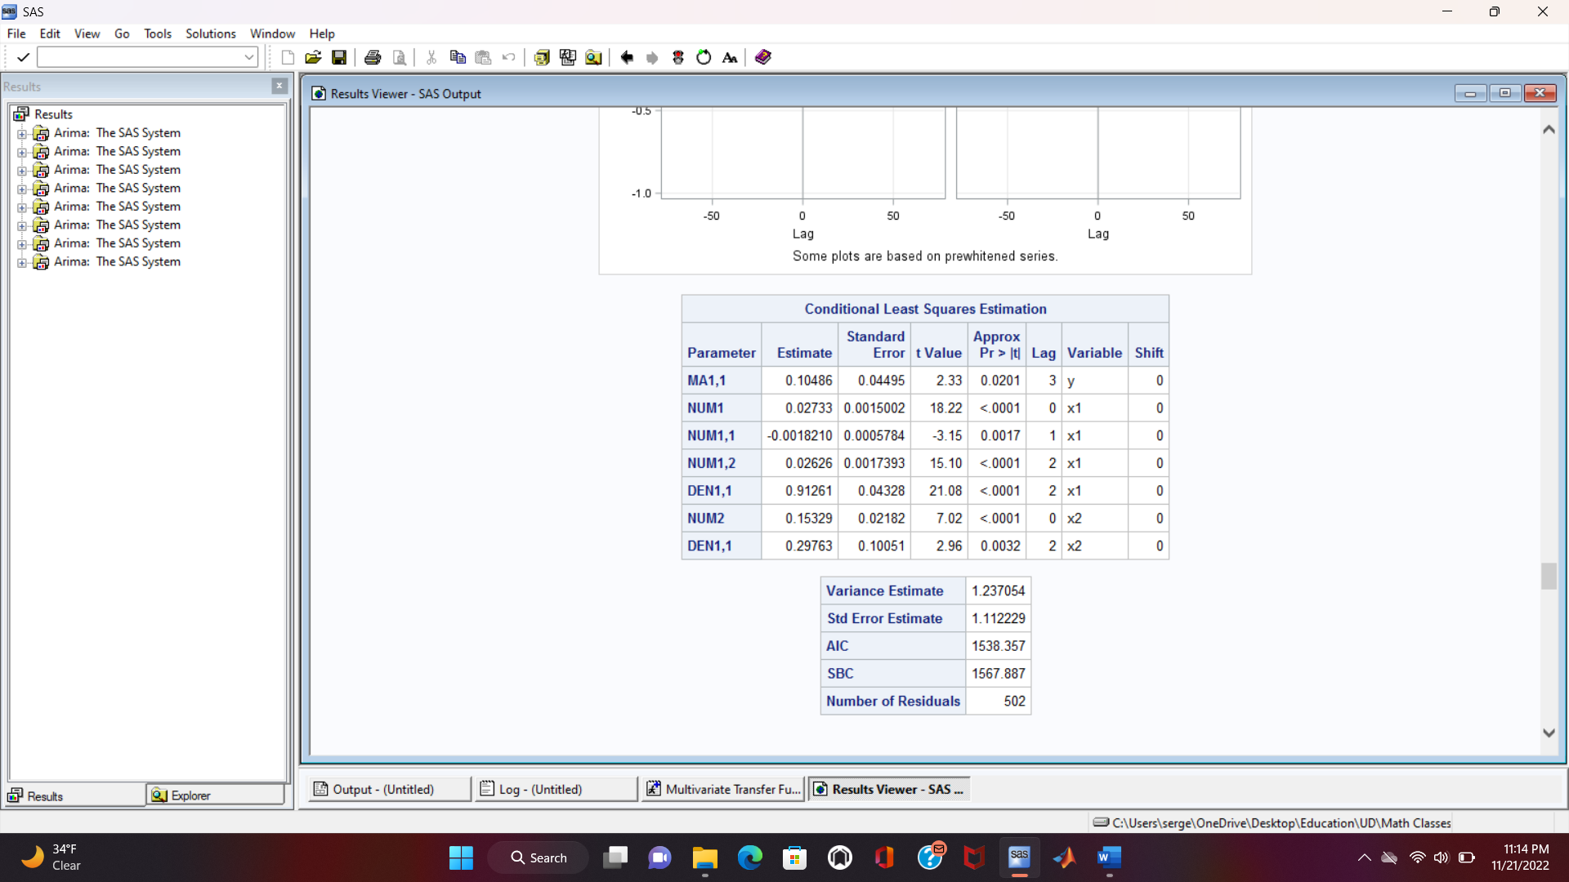
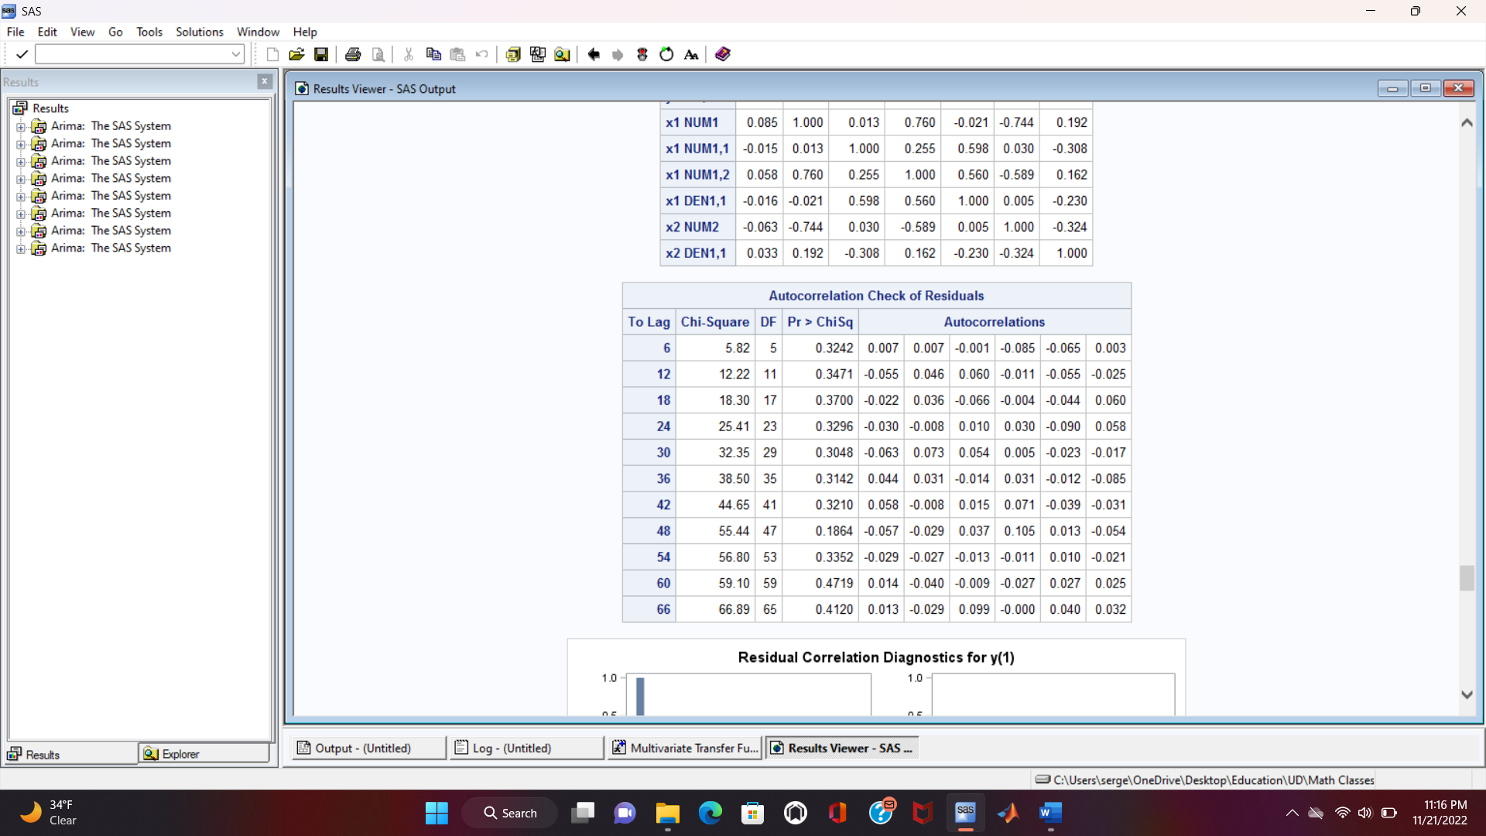
Diagnostics and final model
Final model with modeled noise:
Model: b1=0; r1=1,2; s1=2 b2=0; r2=0; s2=2 q=2
All the parameters are significant
No autocorrelation in the residuals

Slide 36

Diagnostics and final model
Final model with modeled noise:
No spikes in the SAC and SPAC graphs meaning the residuals are not autocorrelated at all lags
The probability for the residuals of being white noise is high

Slide 37

Diagnostics and final model
Final model with modeled noise:
The distribution of the residuals should be close to a Gaussian one centered at zero
There is more probability that the residual will have a zero value

Slide 38

Diagnostics and final model
Final model with modeled noise:
The equation of the model can be written now after the least squares estimation of the parameters

Slide 39

Diagnostics and final model
Other tests:
P-values are high meaning that no cross-correlation is left between the whitened first input and the whitened output
In other words, x1 best explained y as much as it could through b1, r1, and s1

Slide 40

Diagnostics and final model
Other tests:
P-values are high meaning that no cross-correlation is left between the whitened second input and the whitened output
In other words, x2 best explained y as much as it could through b2, r2, and s2

Slide 41
Forecasting Results

Slide 42
Conclusion
The parameters of the model are significant implying that the model is fit
The adequacy tests are passed indicating that the model is adequate
The error between the actual values and the forecasted ones is small demonstrating that the model is accurate
Other metrics, such as the standard error and the mean squared error, can help determine whether the forecast is accurate
Outlier detection tests with a certain level of confidence can also be used to identify any outliers. Furthermore, detected outliers can be modeled to improve the overall model
It should be noted that various types of interventions can be modeled and added to the final model to improve it
More analysis, equations, and explanation are available in the report
The implementation was done in SAS
Questions/Comments?

Slide 43
References
Books:
George E. P. Box - Time Series Analysis Forecasting and Control (2015) 5th
Douglas C. Montgomery - Design and analysis of experiments (2017) 10th
Data:
Yahoo Finance
Software:
SAS: The code is in my GitHub account
Excel
Google Charts

Slide 44
THANK YOU!

